Slide 1
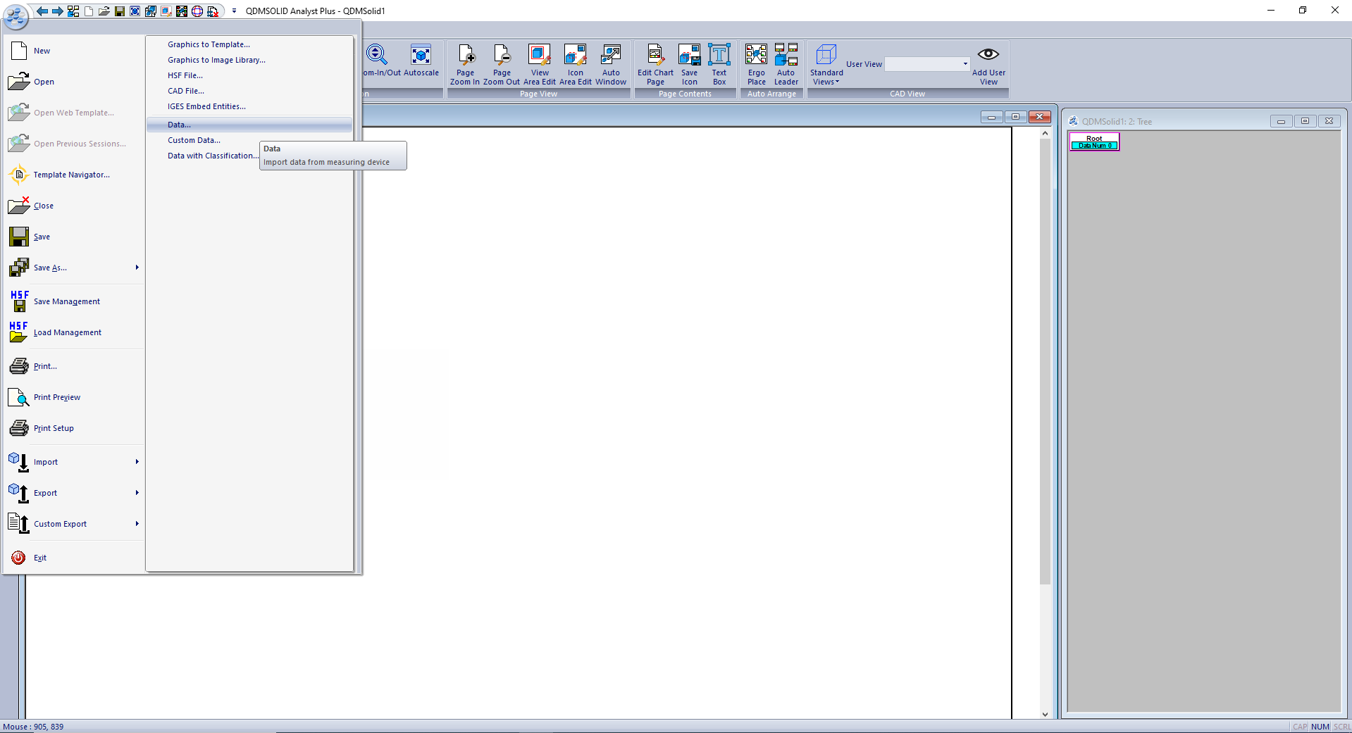
Importing Translator to QDM3D
In QDM3D: Start → Import → Data

Slide 2
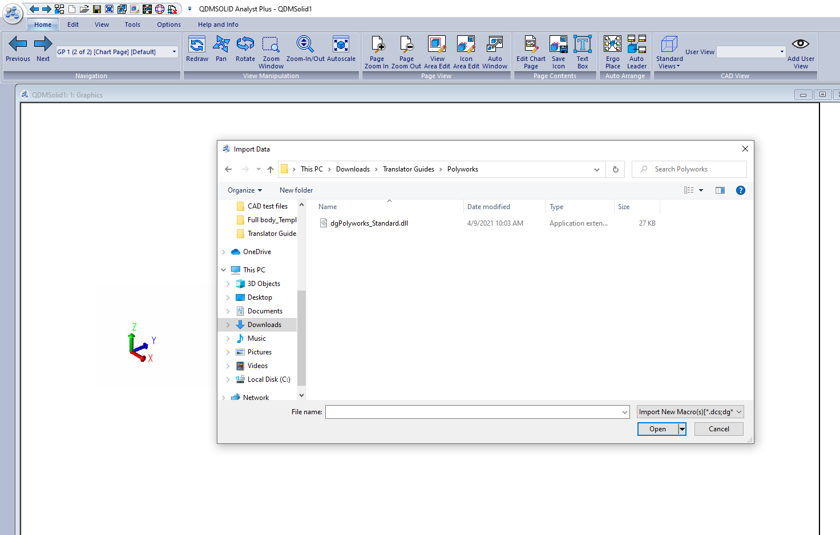
Importing Translator to QDM3D
Select “Import New Macros” in the dropdown menu and select your translator, e.g. “dgPolyworks_Standard”

Slide 3
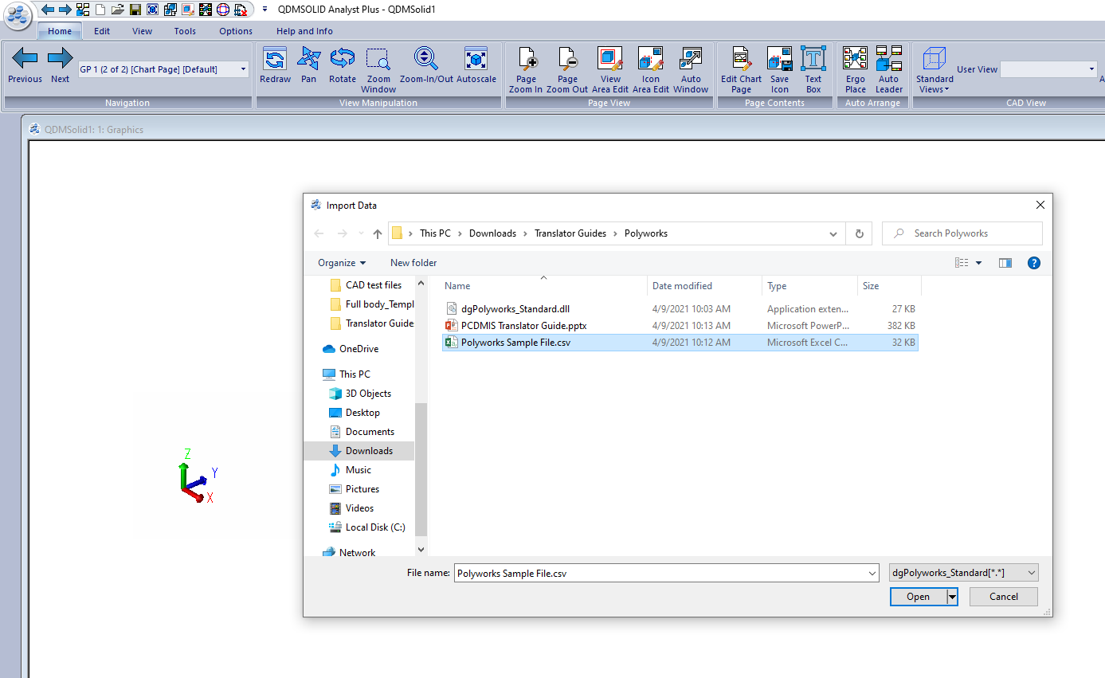
Importing sample file in QDM3D
Go to Start → Import → Data
Select your sample file
Select the translator name in the dropdown menu

Slide 4
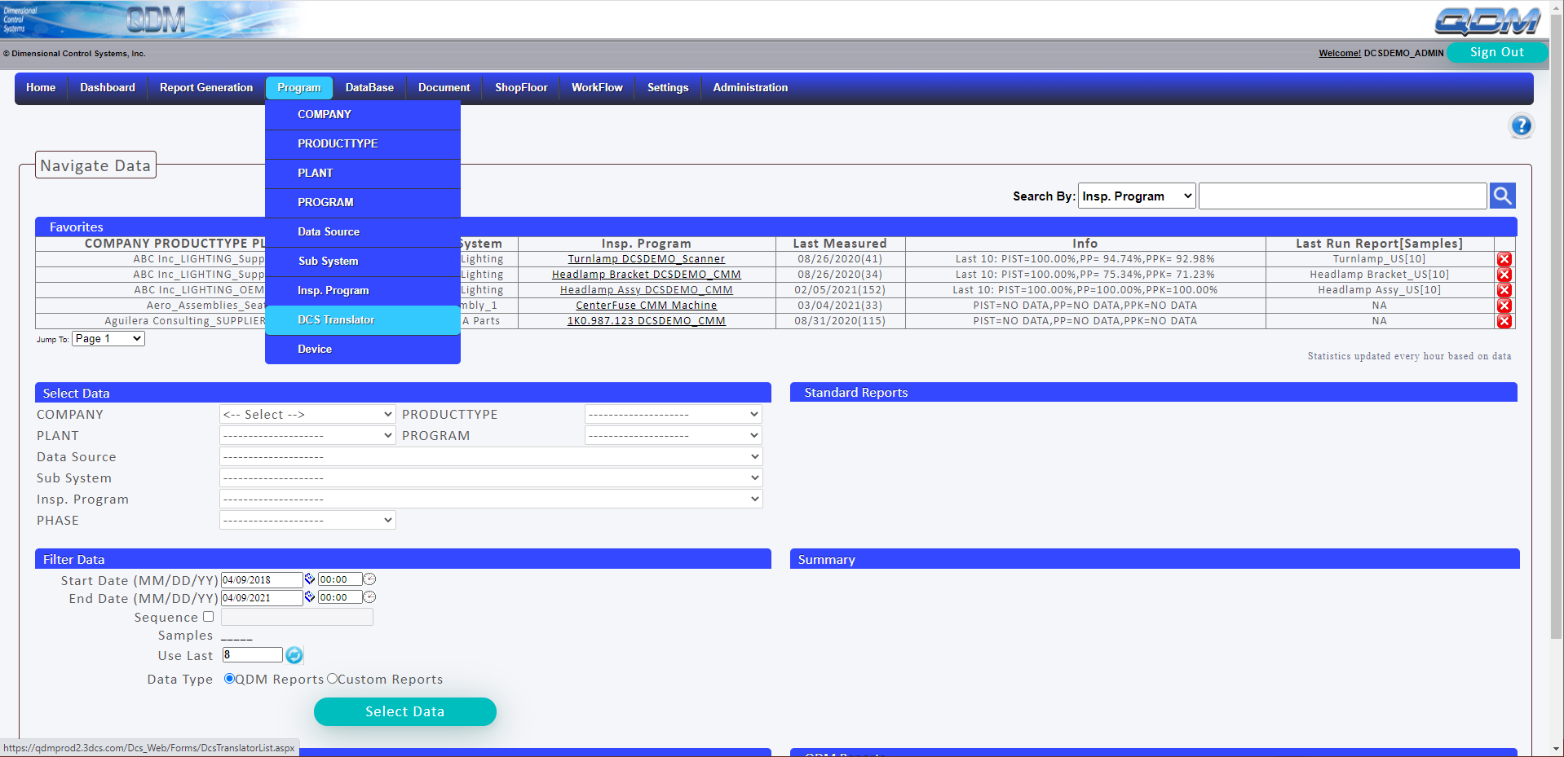
Importing Translator to QDMWEB
In QDMWEB: Program → DCS Translator

Slide 5
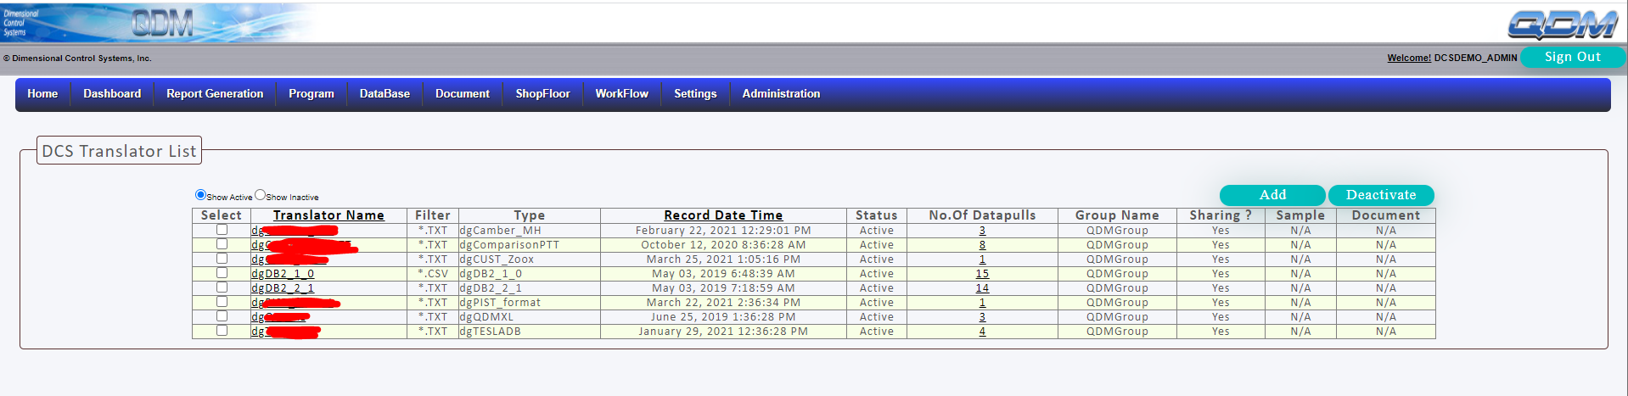
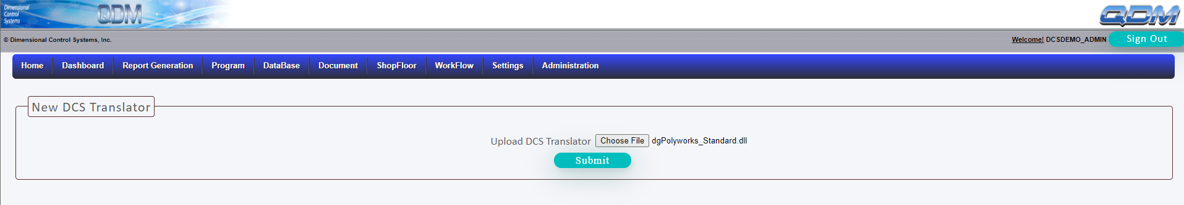
Importing Translator to QDMWEB
Click “Add”
Choose the file “dgPlolyworks_Standard” and Submit

