Slide 1
GOM Translator Guide
Date: 4/30/2021
Macro Name: dg GOM_Standard
Macro Description: Macro for GOM csv files
Created By: Rishi Rughooputh
Reference DCS USE ONLY: https://helpdesk.3dcs.com/WorkOrder.do?woMode=viewWO&woID=69371

Slide 2
Objective
This guide will help you understand what file structure is required for the GOM translator to work.
The format of the file needs to match the format of the sample file shown.
Any changes to the format may cause issue in reading the file correctly.
This package contains:
2 GOM Sample measurement files
Sample file with date
Sample file with no date
GOM Translator
PowerPoint Document highlighting different sections required in a sample file.
PowerPoint Document showing how to import a translator & sample file to QDM3D & QDMWeb

Slide 3
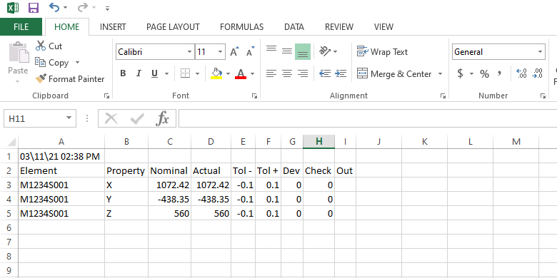
Sample file (with date) format
Header Info
JSN
Date & Time
Each Measurement
3. Feature name
4. Attribute name
5. Nominal value
USL
LSL
1
The CSV filename will be used
2
5
7
6
3
4

Slide 4
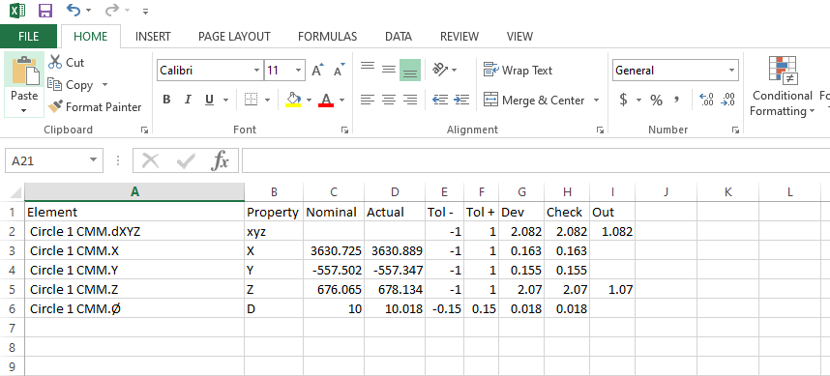
Sample file (no date) format
Header Info
JSN
Date & Time
Each Measurement
3. Feature name
4. Attribute name
5. Nominal value
USL
LSL
The GOM translator can read this second file format as well. It is similar to the first format except there is no header for the date and time.
1
The CSV filename will be used
2
The date and time of the CSV file will be used
3
4
5
7
6

