Slide 1
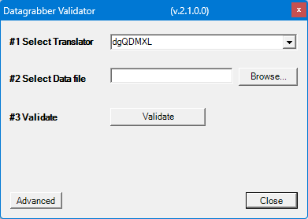
Importing Configuration File to QDM3D
Select DCS Data Grabber on the “Tools” menu
Select the Advanced button on the Datagrabber Validator dialog box
1
2
3

Slide 2
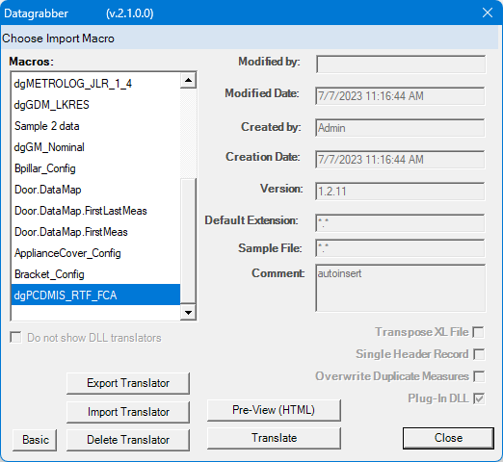
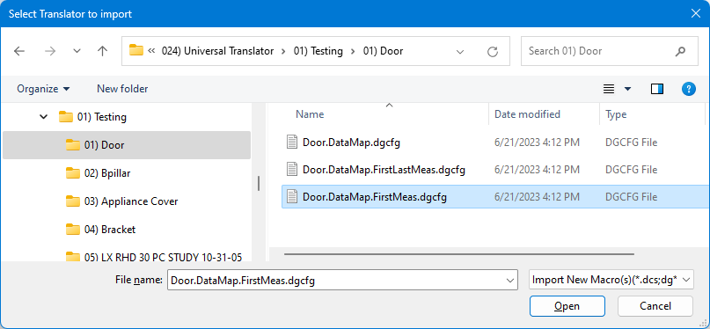
Importing Configuration File to QDM3D
Select the Import Translator button on the Datagrabder dialog box
Select your Configuration File, e.g. “Door.DataMap.FirstMeas.dgcfg”
Select the Open button on the Select Translator to import dialog box
2
1
3

Slide 3
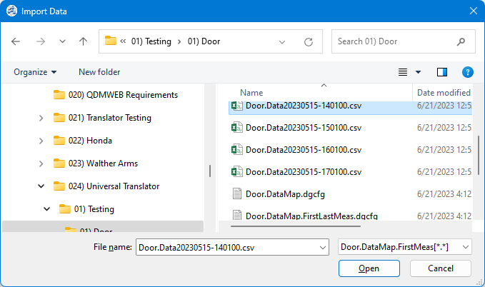
Importing sample file in QDM3D
Go to Start → Import → Data
Select the Configuration File name in the dropdown menu
Select your sample file and select Open

Slide 4
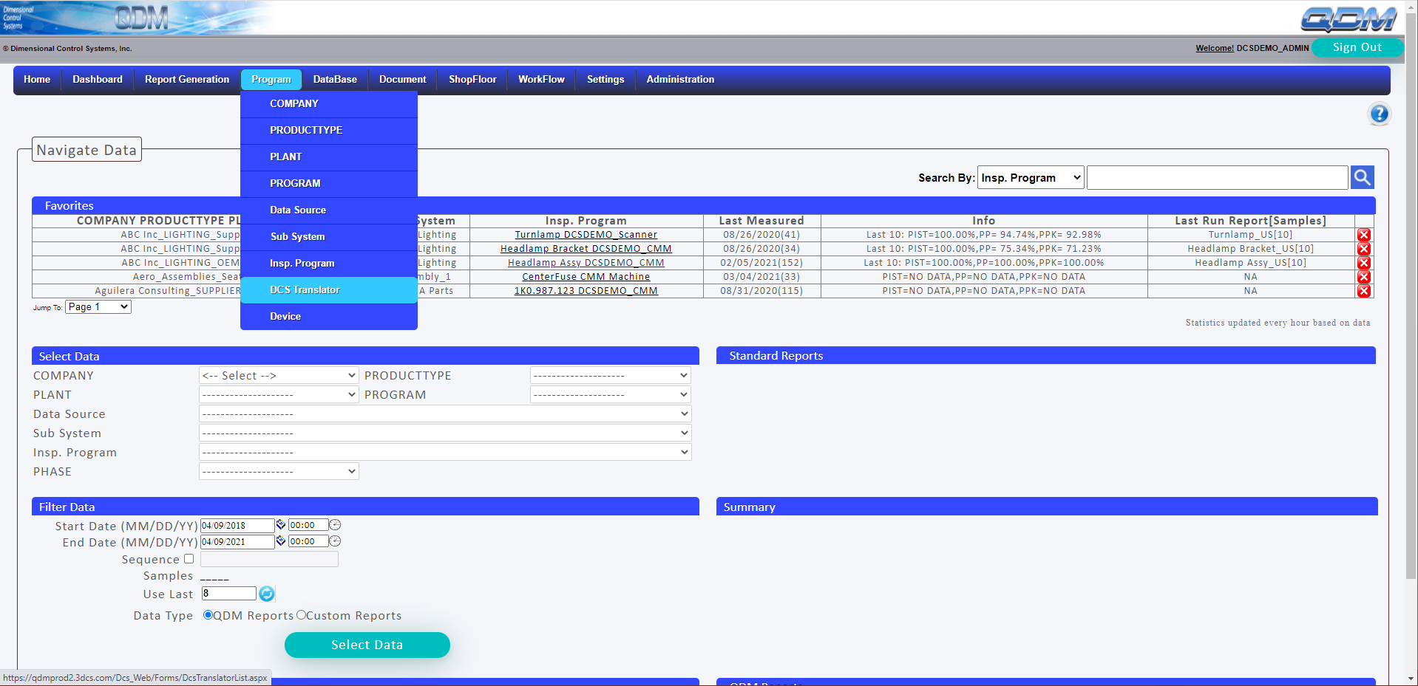
Importing Configuration File to QDMWEB
In QDMWEB: Program → DCS Translator

Slide 5
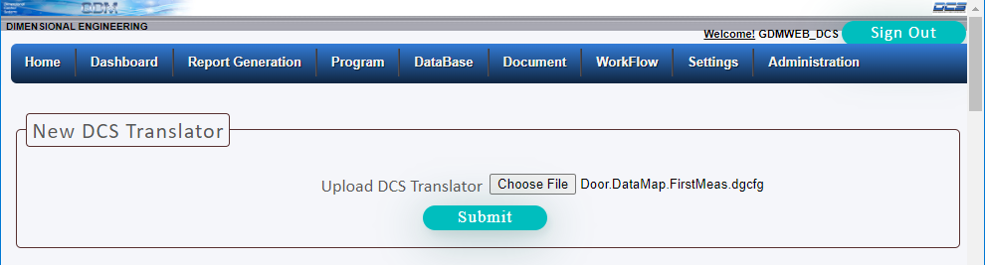
Importing Configuration File to QDMWEB
Click “Add”
Click ‘Choose File’ and select the dgcfg file, “Door.DataMap.FirstMeas.dgcfg” and Submit

